Slide 1

Proofs
Lecture 7.5
Wrapping up Induction
By Ariel Avshalom

Slide 2
Going over proofs from last class
The next 20-40 minutes will be devoted to going through the process of induction proofs.
I will go over the 1st, 2nd, 4th, 5th and 6th proofs in the class notebook.
I recommend you try them first before looking at solutions or how I explain them.

Slide 3
Wow that was a lot!
There are many ways to use induction!
It’s a REALLY powerful tool with many, many applications.
Since this is a CS course, I think it might be prudent to learn a relevant CS skill now
This skill is called a loop invariant (not covered in the book)

Slide 4

What is a loop?
I’m sure all of you think you know what it is by now…
But let's cover it just in case ☺

Slide 5

Back to the basics: a Statement
Recall that a statement is
a meaningful declarative sentence that is true or false
OR
the assertion that is made by a true or false declarative sentence
Statements follow one another in a specific order called control flow
This all stems from the concept of structured programming which have if/else and repetition blocks coded in

Slide 6
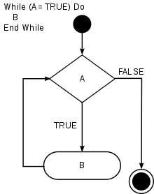
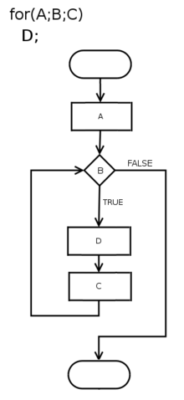
Types of Loops
There are a few types of loops we generally see in CS but here are the main ones:
While
For
Infinite
x = 0.1
while x != 1:
print(x)
x += 0.1
WHAT IS WRONG?
Variable Types

Slide 7
So what is a loop invariant?
All about Lambda Calculus
Before we ask that, we should define which paradigm loop invariants fall under
That paradigm is functional programming
Functional Programming involves building the structure of your code to be exact and never outputting a different result if you insert the same inputs
NOTE: when you code normally, different results happen when you don’t close a file, or you log in as a different user (for example)
This does not happen with functional programming
It’s more difficult to code in, but it is a much more robust way of programming
Languages that adhere to Functional Programming include Haskell and Erlang
Functional Programming can also be implemented in the popular languages like Python and Java

Slide 8


Loop invariant
A loop invariant might have come from the ideas of functional programming, but it can be used everywhere and it has a lot of practical applications
Imagine you’re in a while loop right now
fights = 0
currentFight = 0
while fights < 10:
summon(dragon) #predefined code to summon a dragon
currentFight = fight(player, dragon) #predefined fight initiator code
if currentFight == 1:
print(“winner! “, 10-fights, “ …
…more rounds to go\n!”)
currentFight = 0
fights += 1
else:
print(“You Lost!\n”)
exit()
print(“Game Over”)

Slide 9
A loop invariant does this:
Before the loop starts the loop invariant is true
During the loop, the invariant is checked for truth
When the loop ends, the invariant is no longer true, or
The invariant breaks the loop when its false
In our example before, the invariant was fights, specifically while fights < 10, keep on running the loop
It was true throughout running the loop and once fights = 10, the invariant is no longer true and we exit the loop

Slide 10

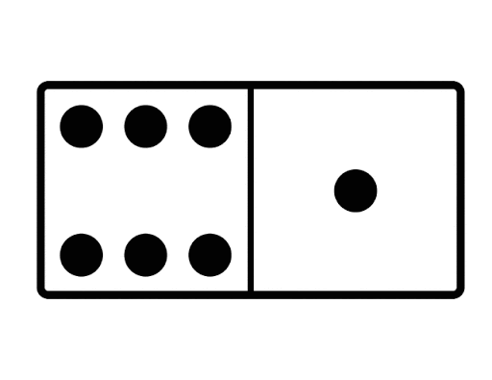
A more interesting example: a chessboard
Say you have a chessboard, and because you’re crazy, you’d like to cover it up with dominoes
A domino covers two spots on the board, so it would take 32 dominoes to fully cover the board
A loop invariant for the above could be
while boardNotCovered:
place a domino on the board
Assuming you can rearrange the dominoes, eventually the invariant will be false and the loop will break

Slide 11
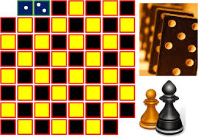
A slight change (CHALLENGE)
What happens, if instead of a normal chessboard, I get rid of the top left and bottom right positions on the chessboard?
Can I fill the chessboard then?
Your challenge is to try this out and construct a loop invariant (one which is more complex than boardNotCovered) which will eventually break the loop
The questions you should solve are:
What is the loop condition (or the invariant)?
Why does or doesn’t the chessboard get covered?
What characteristic is changed by removing those positions from the board?
Writing a program for this would be impressive but it is not required. If you do, you don’t have to go as far as designing a GUI, a simple text checker is fine. I’m inclined to give extra credit to the first 3 people to write code that solves this problem.

Slide 12

Fun stuff: The Halting Problem
There is an interesting problem called the halting problem – being able to tell if a program ever completes or terminates.
Alan Turing proved that no algorithm exists which can determine if an arbitrary program will eventually halt for a given input.
The proof is very beautiful and computerphile shows it in their undecidability set:
https://www.youtube.com/watch?v=nsZsd5qtbo4
https://www.youtube.com/watch?v=nsZsd5qtbo4
https://www.youtube.com/watch?v=lLWnd6-vSGo –this one specifically
They also talk about it here:
https://www.youtube.com/watch?v=macM_MtS_w4 –this one is specifically about turing

